Slide 1
New York City
DMC Report Summary
Vera Institute of Justice
Yumari Martinez
December 13, 2011

Slide 2
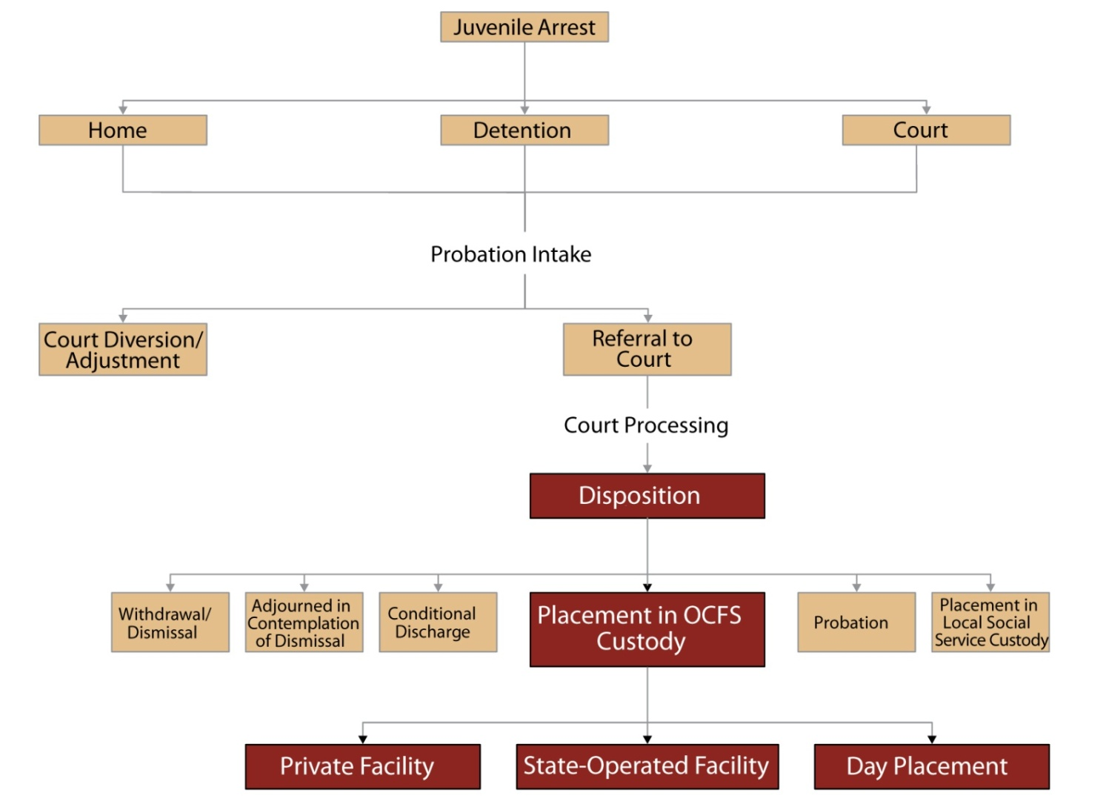
Local Juvenile Justice System Basics
What are the key components of the system?

Slide 3
Local Juvenile Justice System Basics
What are the key components of the system?
January 2006:
  NYC closes sole Alternative to Detention (ATD) program
  Stakeholders convene to respond to service gap
Development and Implementation
  Risk Assessment Instrument (RAI)
  New Continuum of Alternatives to Detention

Slide 4
Local Juvenile Justice System Basics
What are the key components of the system?

Slide 5
Overview of Local DMC Problem
What does the issue look like within this jurisdiction?
  Youth of color are 44% of state’s youth population
  Roughly 88% of the youth arrested in NYC are either black or Latino – groups that constitute 64% of the City’s youth population
  These youth constitute an even larger share of the juvenile justice population at later stages of case processing:
    92% of youth entering detention;
    90% of youth placed (post sentencing) with private agencies; and
    97% of youth entering OCFS-operated facilities.

Slide 6
Project Goals
What were we hoping to do?
To assess factors contributing to New York City's high rate of Disproportionate Minority Contact in the juvenile justice system
Develop a comprehensive local strategy to reduce the rate of Disproportionate Minority Contact that also relates to and enhances the Statewide effort.

Slide 7
Grant Supported Activities
How were JJ Formula Funds used?
Grant period is 12 months
  Started January 1, 2011
Grant amount was $100,000
  DMC Coordinator, 3 researchers, administrative support
DMC Working Group met 7 times
Coordination with Statewide DMC work
  Quarterly Meetings with Monroe and Onondaga

Slide 8
Grant Supported Activities
How were JJ Formula Funds used?
DMC Working Group
  Identify key target populations/decision points for reform
  Develop recommendations
Research
  Data collection and coordination
  Data analyses
  Focus groups
Community Engagement
  Community meetings
  Focus groups
  Local partnerships
Strategic Plan
  Submitted to DCJS January 31, 2012

Slide 9
Local DMC Workgroup
What structural framework supported the work?

Slide 10
Local DMC Workgroup
What structural framework supported the work?
Review and Analyze DMC Data
  Develop questions and share observations related to DMC data
  Identify any racial disparities at each system point
  Recommend areas for further examination
Develop Recommendations to Address Disparities
  During each discussion identify possible recommendations
  Identify any additional information needed to support a possible recommendation

Slide 11
Local DMC Workgroup
What structural framework supported the work?
Assist in Outreach Efforts
  Facilitate and help organize outreach to each member’s representative group
  Assist in strategizing most effective ways to reach out to communities across New York City
Assist in the Development of DMC Reduction Plan
  Develop recommendations
  Assist in editing and commenting on drafts
  Assist in strategizing for the implementation of the recommendations

Slide 12
Quantitative Data Analysis: Methods
Several analytical techniques:
  RRI
    All points
  Descriptive
    Adjustment, Police Admissions, Detention at Arraignment
  Logistic regression
    Petition, Detention at Arraignment, Sentencing and Placement
Data Sources
  NYC Juvenile Justice Research Database (JJRDB)
  ACS
  DOP

Slide 13
Citywide Relative Rate Indices, 2010

Slide 14
Rate of DETENTION AT ARRAIGNMENT by Race & Risk: 2009*
POLICE ADMISSIONS: 2010**
One-quarter of arrests were dropped off at detention by police in 2010. 91% of these were youth of color. Of white arrests, 10% were dropped off by the police compared with 28% of black arrests and 21% of Latino arrests.
76% of these police admissions were released the next day. This was consistent across racial groups, however the majority of those released within one day are youth of color.
57 white youth stayed in detention for one day compared with 1334 black youth and 539 Latino youth.
95% (449) Youth of Color
ADJUSTMENTS, 2010**
White non-Hispanic youth are adjusted at twice the rate of Black youth (46% versus 24%).
The majority of youth complete adjustment successfully. When broken down by race, there is about a 5% difference in the rate of successful completion between white youth and black youth (90% versus 85%)
94% (477) Youth of Color
91% (184) Youth of Color
339 mid risk youth of color detained for a low to mid severity offense
133 low risk youth of color detained for a low to mid severity offense

Slide 15
Qualitative Data Collection
How did the project gain qualitative information?
Six focus groups with youth
  Probation, detention, ATD, & ATP
  Non-system-involved youth
Two focus groups with adults
  Parents with system-involved youth
  Adults with criminal and/or juvenile justice system experience
  Community leaders
Asked several open-ended questions regarding perceptions of fairness of interactions with police, judges and other system players

Slide 16
Qualitative Data: Major Themes
46 references to the presence and practices of police
  Both positive and negative perceptions of police
Differential treatment by police
  Findings were mixed
Judges and system fairness
  Generally positive perceptions about the judge and fairness of punishments

Slide 17
Summary & Recommendations
What can be done to address/support key findings?
Some of the system points the Working Group has identified for possible recommendations:
    Police Referrals to Detention
    Front Door of Detention
    Adjustment at Probation
    Detention at Arraignment
Notes:
Highlight key findings and potential areas for intervention. Discuss specific ideas, activities, plans for change at the local level; also include recommendations for statewide interventions, if appropriate.

Slide 18
Next Steps
How will the DMC initiative be sustained?
Finalize DMC Report (Jan 31, 2012)
Finalize findings from focus groups
Look for new funding:
  Continue DMC Working Group (Quarterly basis)
  Identify a specific system point to focus reform efforts
  Assist in developing model data collection and analyses practices
Notes:
Discuss specific short-term activities/plans that have resulted from the project findings re: RAIs, alternatives to detention, building capacity for data analysis and community engagement. Also discuss the status of the local DMC workgroup and plans to sustain DMC work beyond the grant period. Include information re: availability of resources to support activities and possible challenges to successful implementation.

Slide 19
Final Thoughts
What should the JJAG know about the process?
Contribution of diverse interested parties
Great attendance and investment of time
Trust and comfort over time
Not enough time to review all system points
Some tough calls and diverse approaches
More focus on front end
Moving target with impact of current reforms
Addressing a system that is almost all of color
Notes:
Discuss any other project-specific information that may have not been included elsewhere in the presentation, ie. unique project components, unanticipated findings, ideas for future statewide efforts.

