Slide 1

Monroe County’s
DMC Final Report
Monroe County Probation
Leslie S. Barnes, Deputy Chief Probation Officer
Anne Goewey, Probation Supervisor
Hattie M. Henderson, DMC Coordinator
December 13, 2011

Slide 2
Local Juvenile Justice System Basics
Arresting Agencies
Detention/Appearance Tickets
Probation
Family Court
Juvenile Prosecutor’s Office

Slide 3
Local Juvenile Justice System Basics
What are the key components of the system?
Monroe County Probation Family Service Division (FSD) Overview:
Family Access and Connection Team (Fact) (pre-diversion PINS)
Intake/Diversion (non-adj. PINS/JD’s)
PDI’s (Pre-Dispositional Investigations)
General Supervision
Family Court Liaison and ATD Officers - HOJ
Intensive supervision

Slide 4
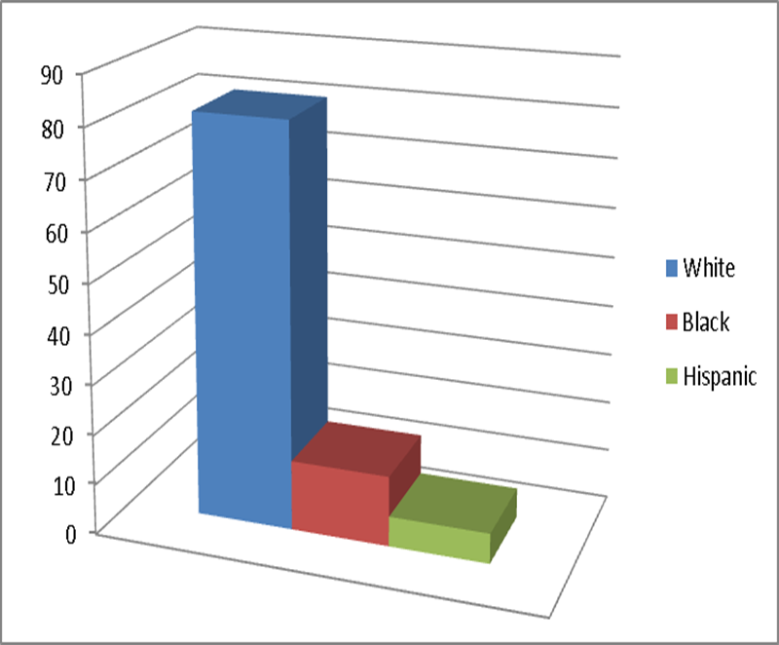
Total Monroe County Population
(2009 USCB)
Population: 733.703
Race/Ethnicity
81% White
14% Black:
6% Hispanic Origin

Slide 5
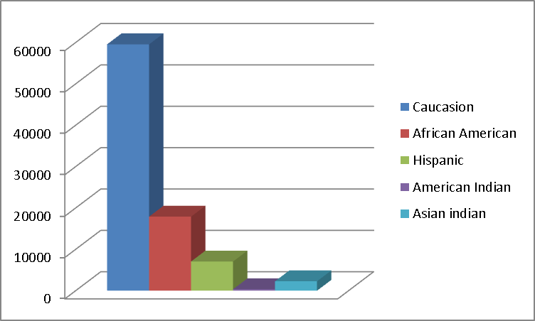
Total Number of Youth In Monroe County (ages 10-17); 80,125
African American 17,914
American Indian 352
Asian Indian 2,289
Caucasian 59,570
Latino/Hispanic 7,065*
Includes 17 year olds in numbers

Slide 6
Overview of Local DMC Problem
What does the issue look like within this jurisdiction?
Black youth comprise 21% youth population age 10 -16, but represented 58% of arrests
Black youth made up 76% of detention admissions
Black youth were 5 times more likely than whites to be arrested
Black youth were 20 times more likely to be admitted to secure detention

Slide 7
Overview of DMC in Monroe County
2010 Secure Detention Admissions
White Black Latino Other Total
Youth Population (10-16) 44874 14313 6477 2092 67756
Percent of Youth Population 66% 21% 10% 3% 100%
Arrests 267 439 9 40 755
Percent of Arrested Youth 35% 58% 1% 5% 100%
Rate per 1000 Youth in Population 5.9 30.7 1.4 19.1 1.4
Admissions 78 489 53 25 645
Percent of Admitted Youth 12% 76% 8% 4% 100%
Rate per 1000 Youth in Population 1.7 34.2 8.2 8.2 8.2

Slide 8
Project Goals
What were we hoping to do?
Bring Recognition to Disparities In JJ & CW
Obtain Accurate Local Data
Partnership with a committee of local stakeholders to Formulating Strategies
To work with Burns Institute to Develop a Comprehensive Strategic Plan to Improve and Eliminate Racial and Ethnic Disparities
Incorporating the voices of youth and families

Slide 9
Project Goals (cont.)
DMC/DMR cross systems collaboration (DHS)
DMC/DMR Work group
Strategy Team
Identify a Target Population
Connecting ATD with DMC
Moving in a parallel directions with DHS
Providing Fair and Equal Treatment to ALL Youth and Families

Slide 10
Grant Supported Activities
How were JJ Formula Funds used?
Full time DMC Coordinator
Attended DMC Conference Sponsored by Black Administrators in Child Welfare
Focus groups
  Food
  Gift cards

Slide 11
Other DMC Related Activities
Attendance at Community Conferences
Disparities in Health Care
Rochester Black Boys and Men's Symposium Rochester City School District
DMR Casey Family Foundation Training
Institutional Analysis
Literature Review
Group Presentations & Individual Contact With Stakeholders , Youth and Families

Slide 12
Local DMC Workgroup
What structural framework supported the work?
Planning Committee was to act in an advisory capacity and was comprised of:
  Chief Probation Officer
  Director of Child & Family Services (DHS)
  Deputy Chief Probation Officer
  DHS Administrators
  Probation Supervisor
  Local DMC Coordinator

Slide 13
Local DMC Workgroup (cont.)
DMC/DMR Strategy Team consisted of local stakeholders from the:
  Juvenile Justice Council
  DHS
  Law Enforcement
  School Personnel
  Family Court Staff including a Family Court Judge
  Faith Based community
  A parent
  A Youth

Slide 14
Local DMC Workgroup (cont.)
Strategy Team Local Stakeholder
  Mental Health Staff
  Legal Aid Society (attorneys for the child)
  Juvenile Prosecutor’s Office
  Office of Children and Family Services
  Planning committee met bi-weekly
  Strategy Team met monthly
  Identified Target Population: Secure Detention led to merger with ATD Steering Committee

Slide 15
Quantitative Data Analysis
What has “digging deeper” revealed?
Target Population Identified: Secure Detention
DHS Detention Data: Detention Admissions in 2010
 | White | Black | Latino | Other | Total
Total Admissions | 78 | 489 | 53 | 25 | 645
MCFC Remands | 27 | 191 | 28 | 11 | 257
Percent Of Admissions that are Remands | 35% | 39% | 53% | 44% | 40%
Race/Ethnicity | 11% | 74% | 11% | 4% | 100%

Slide 16
Quantitative Data Analysis (cont.)
Youth Detained 1 -4 days
MCFC remands and OCFS warrants constituted 57% 0f 1 – 4 admissions
35% are MCFC remands
22% are OCFS warrants
43% of 1 – 4 day admissions are Police admits
63% of 1 – 4 day admission stay 1 day
MCFC remands and Police admits comprise 78%of 1 day admissions (each are at 39%)

Slide 17
Quantitative Data Analysis (cont.)
Youth with a Low RAI Score
RAI outcome Jan-Dec 2010 DHS
 | Jan | Feb | Mar | Apr | May | Jun | First 6 months of 2010 | Percent of youth detained with RAI risk Level
Low | 6 | 10 | 9 | 10 | 12 | 10 | 57 | 50%
Med | 2 | 2 | 4 | 3 | 2 | 1 | 14 | 12%
High | 5 | 5 | 3 | 8 | 13 | 10 | 44 | 38%
Total | 13 | 17 | 16 | 21 | 27 | 21 | 115 | 100%

Slide 18
Quantitative Data Analysis (cont.)
Youth With A Low RAI
Risk Assessment Instrument (RAI)
Tool to help guide juvenile detention decisions
RAI designed to determine youth risk of re-offending or failing to appear in court
Further analyze the reasons for judicial use of detention
Why youth with low RAI scores comprise almost half of admission detentions

Slide 19
Qualitative Data Collection
How did the project gain qualitative information?
Focus Groups/Youth
  Personal Safety concerns
  Easy access to drugs and guns
  Feeling of disconnection and struggle to find positive role models
  High levels of violence in the home & community
  Expected to be treated badly by local police
  Negative experiences in secure detention

Slide 20
Qualitative Data Collection (cont.)
Focus group/Parents & Caregivers
  Left out of decision making process
  Court system is unfair and has double standard
  Mandated programs label kids for money
  Feel judged
  Secure Detention gave a “peace of mind” but there were no long term changes after child returned home

Slide 21
Qualitative Data Collection (cont.)
Institutional Analysis Focus Group
  Youth Group
  Center for Youth Staff
  Attorney for the Child
  CPS Investigators
  Public Defenders
  CPS Management Caseworker
  Parenting Groups
  Court Observation

Slide 22
Summary & Recommendations
What can be done to address/support key findings?
Black youth are overrepresented in Monroe County’s juvenile justice system
Stakeholders should:
Ensure that there is a consistent and accurate methodology that allows youth to self- identify ethnicity as well as their race
Departments and agencies should engage in a discussion on collecting race and ethnicity, Identify racial/ethnic categories that will be collected - as an example, pulling out Latino as a stand alone category

Slide 23
Summary & Recommendations
Development of a program/process to enable access to the three major data systems (probation, detention and UCMS)
Develop a Community Service Matrix
County commitment to coach staff and begin an open dialogue with youth and families
Revisit the use of detention
RAI completed for all youth 24 hours daily

Slide 24
Next Steps
How will the DMC initiative be sustained?
Enhanced ATD Team
Improved Data Collection
DMC/DMR Mission/Vision statement Displayed , Posted and Shared Within the Community
RAI completed 24 hours daily 7 days on all youth at the point of arrest

Slide 25
Final Thoughts
What should the JJAG know about the process?
Only the first step in a long process for change
There is a great deal of work needed to provide staff with awareness of DMC and its impact on youth and families
Paradigm shift working with families of color from What’s wrong with you? to
What happened to you?
Race Matters

