Slide 1
Onondaga County
DMC Final Report
Center for Community Alternatives
Emily NaPier
Juanita Gamble
Co-Coordinators
December 13, 2011

Slide 2
Local Juvenile Justice System Basics
What are the key components of the system?
Police: 30+ separate departments
Diversion: Probation Department
Family Court
  County Attorney’s Office
  3 judges hear JD cases
RAI: administered at the door of detention for police dropoffs, but not court remands
Lack of true ATDs
Detention

Slide 3
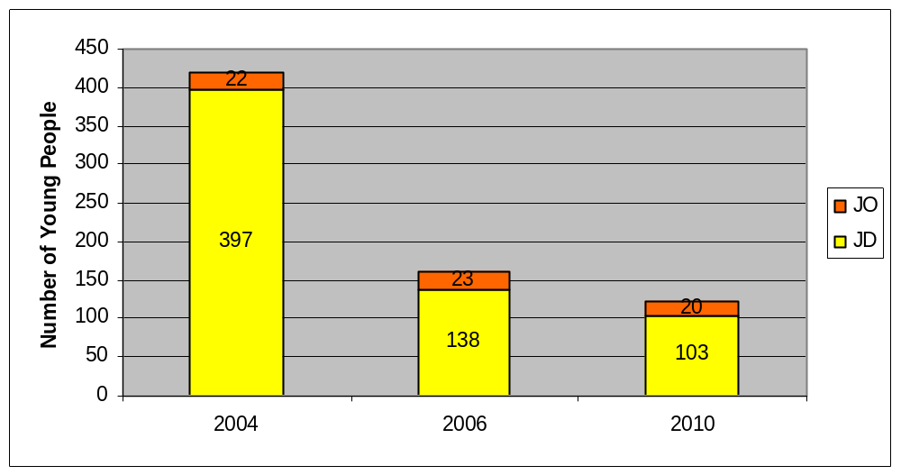
Local Juvenile Justice System Basics
Juvenile Justice Reform
74% reduction in JD admissions
RAI launched at end of 2007
Reduction in Secure Detention Admissions, Onondaga County, 2004-2010

Slide 4
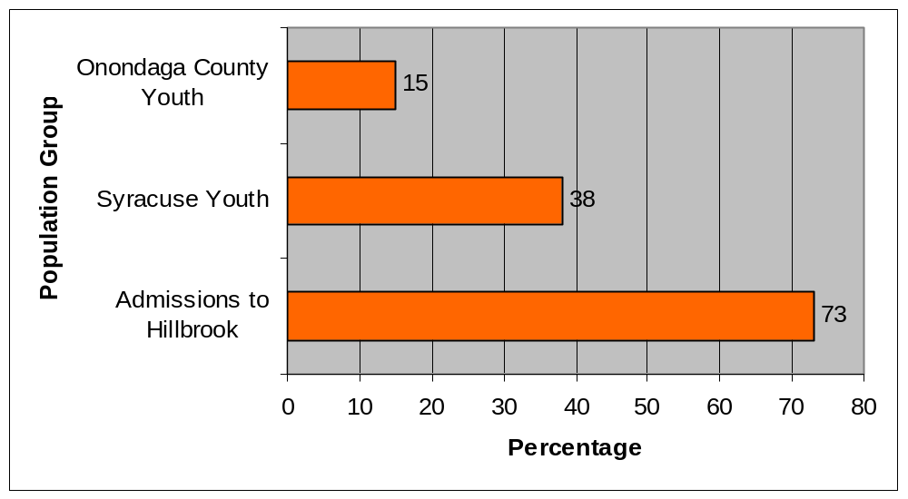
Overview of Local DMC Problem
What does the issue look like in Onondaga County?
African American Youth as a Percentage of Population Groups
in Onondaga County and Syracuse, NY, 2010
Black youth are detained at a rate almost 5 times as high as their proportion in the County’s population

Slide 5
Overview of Local DMC Problem
What does the issue look like in Onondaga County?
Youth Population vs. Juvenile Arrests, Onondaga County and Syracuse, NY

Slide 6
Project Goals
What were we hoping to do?
Convene a DMC work group consisting of system and community stakeholders (subcommittee of the Juvenile Justice Reform Steering Committee)
Analyze quantitative data on DMC
Collect and analyze qualitative data on DMC
Provide community education on the juvenile justice system and DMC
Identify data-driven recommendations to reduce DMC

Slide 7
Grant Supported Activities
How were JJ Formula Funds used?
$100,000 for one year
One full-time and one part-time local coordinator
  Staff DMC work group
  Conduct quantitative and qualitative data analysis
  Provide community education
  Train and support community members (stipends)
  Participate in other local and statewide juvenile justice meetings
  Participate in local meetings regarding DMR in the child welfare system

Slide 8
Local DMC Work Group
What structural framework supported the work?
DMC work group met 8 times (monthly February to September)
Co-chairs
  Deputy Commissioner of Probation
  Community member/parent
Strong community representation from affected populations
  3 African American parents
  1 African American young person

Slide 9
Local DMC Work Group
What structural framework supported the work?
Community organizations: Say Yes to Education, Mothers Against Gun Violence, Boys & Girls Club
Government agencies: Probation Department, Detention, Syracuse Police Department, County Attorney’s Office, Family Court judges, ON CARE (System of Care grant addressing adolescent mental health and child welfare)

Slide 10
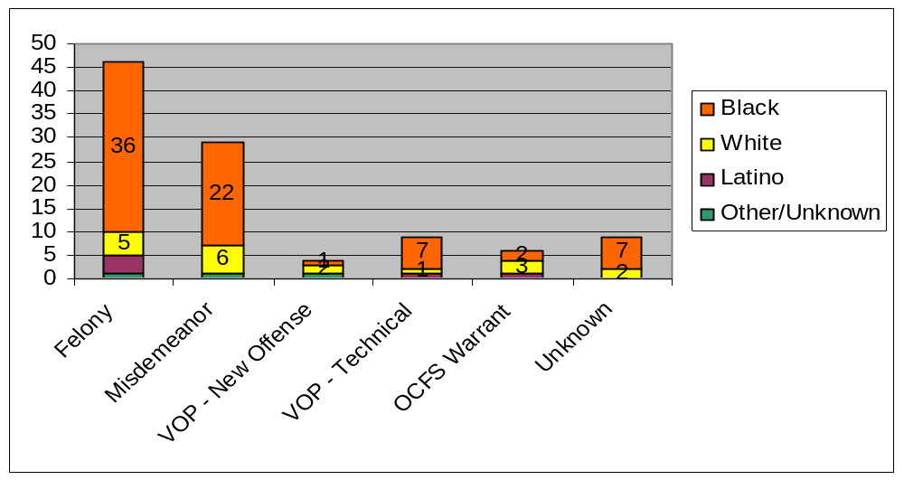
Quantitative Data Analysis
What has “digging deeper” revealed?
More than 1/3 of admissions (37%) were for misdemeanors or technical VOPs
Secure Detention Admssions in Onondaga County, by Offense and Race, 2010

Slide 11
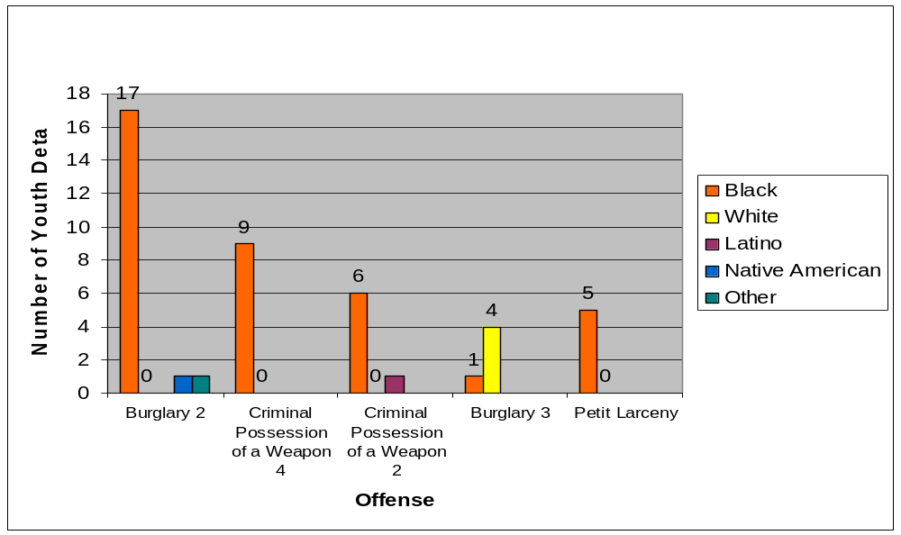
Quantitative Data Analysis
What has “digging deeper” revealed?
Top Five Criminal Offenses for Secure Detention Admissions
in Onondaga County, by Race, 2010
Two of the top five offenses were misdemeanors. All of the youth detained on those charges were Black.

Slide 12
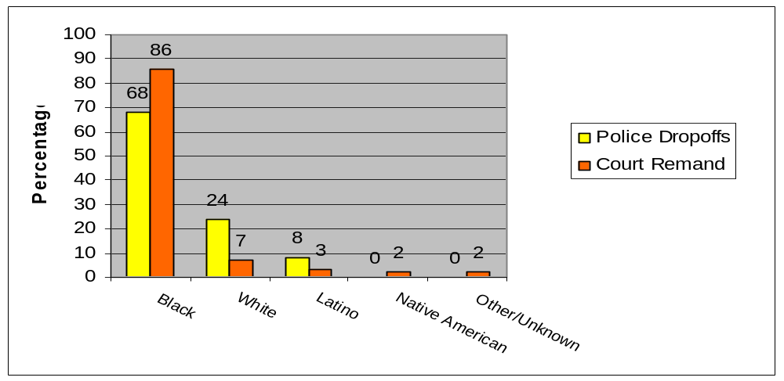
Quantitative Data Analysis
What has “digging deeper” revealed?
Race of Youth, by Referral Source, 2010 Secure Detention Admissions
in Onondaga County (N=88)
55% of Black youth admitted to Hillbrook are remands

Slide 13
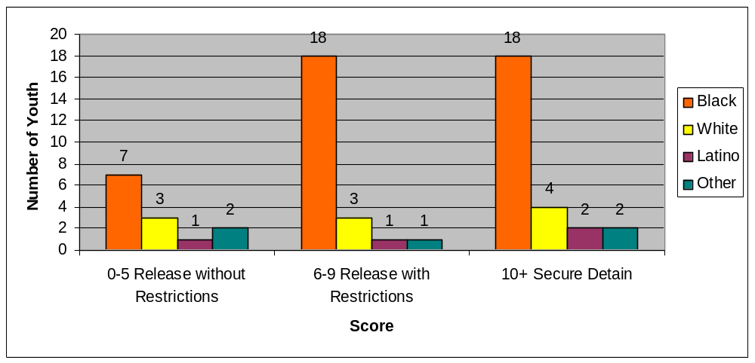
Quantitative Data Analysis
What has “digging deeper” revealed?
Risk Assessment Instrument (RAI) Scores in Onondaga County, by Race, 2010 (N=62)
58% of youth screened scored low or medium risk

Slide 14
Quantitative Data Analysis
What has “digging deeper” revealed?
RAI Override Rates in Onondaga County, 2010
20 of the 36 youth who did not score for detention were detained.
That’s a 56% override rate.
65% of the youth detained on overrides were Black.
10% were white.

Slide 15
Quantitative Data Analysis
Target Populations
Youth detained on low-level criminal law offenses (misdemeanors)
Youth detained on technical violations of probation
Youth with low RAI scores detained because of an override

Slide 16
Qualitative Data Collection
How did the project gain qualitative information?
Interviews with key system stakeholders to better understand how the system typically functions
Focus groups with parents and youth affected by the juvenile justice system and with community members generally concerned about the issues
Community education forums
DMC work group meetings

Slide 17
Qualitative Data Collection
What were the findings?
3 focus groups with 7 teenagers, 6 parents, and 6 community members
21 community education forums with 150+ participants
Themes
  Youth and parents not “heard” by the system
  Lack of transparency in the system
  Confusion around roles of system stakeholders
  Over-policing of youth in the City of Syracuse
  Lack of activities and opportunities for youth in Syracuse
  System is punitive rather than supportive

Slide 18
Summary & Recommendations
What can be done to address/support key findings?
Continue to monitor DMC through the collection and analysis of data.
Fully implement the new RAI with integrity.
Continue to build system and community partnerships.
Ensure that DMC reduction is integral to juvenile justice reform.

Slide 19
Next Steps
How will the DMC initiative be sustained?
DMC work group will continue to meet on a bimonthly schedule
Onondaga County funding the System of Care initiative to build capacity for quantitative data collection and analysis
Potential DCJS support for continued community engagement work at CCA
  Community task force to work on concrete projects informed by the recommendations
  Training and support for community members to serve on the DMC work group and facilitate community education forums

Slide 20
Final Thoughts
What should the JJAG know about the process?
Difficult to get everyone speaking the same language about DMC in a one-year period; need for DMC 101 for system stakeholders
Community engagement was well-received by system stakeholders but cannot be sustained without deliberate effort and adequate resources

